Slide 1
JDBC [Java Database Connectivity]

Slide 2
Client Server Computing
Database Servers
Database Clients

Slide 3
DEFINING JDBC
JDBC is an API (Application Programming Interface) that helps a programmer to write Java programs to connect to a database, retrieve the data from the database and perform various operations on the data in the Java program.

Slide 4
UNDERSTANDING ‘API’
Every database vendor provides a document representing all the commands to connect and utilize the database features. This document is called ‘API’.
API document is a file that contains description of all the features of a software, a product or a technology.

Slide 5
Oracle vendor provides details in its API document:
oLog(): to connect to oracle database
oexec(): to execute a command
oLogoff: to disconnect from oracle
MySQL vendor provides details in its API document:
mysql_connect(): to connect to database
mysql_execute(): to execute a command
mysql_disconnect: to disconnect

Slide 6
Challenge
As a separate set of functions are provided in each API document of different databases so programmers have to learn and remember different function names.
Solution: A common API – “ODBC”
By using the functions of this common API document, programmers can communicate with any database.
It is created by Microsoft Corporation.
If any organization creates a software depending on this ODBC document, it is called ODBC Driver.

Slide 7
Solution Continue…
In the same way, Sun Microsystems Inc. has also created an API document names JDBC ‘API’ and the actual software which is created according to the JDBC ‘API’ is called JDBC driver.
JDBC API is defined in java.sql package
This package contains interfaces like Connection, Statement, ResultSet, PreparedStatement, Driver and classes like Date, Time, DriverManager etc.
e.g.: classes12.jar is a driver developed by Oracle corporation. Mysql-connector-java-3.0.11-stable-bin.jar is a driver by MySQL database. jdbc-odbc driver provided by Sun Microsystems.

Slide 8
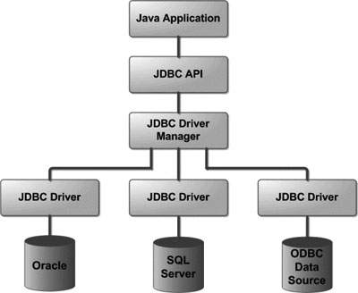
Following is the architectural diagram, which shows the location of the driver manager with respect to the JDBC drivers and the Java application −

Slide 9
Stages in a JDBC Program
Registering the driver
Connecting to a database
Preparing SQL statements in Java
Executing the SQL statements on the database
Retrieving the results
Closing the connection

Slide 10
ORACLE
import java.sql.*;
class OracleData
{
public static void main(String args[]) throws Exception
{
DriverManager.registerDriver(new oracle.jdbc.driver.OracleDriver());
Connection con = DriverManager.getConnection( “jdbc:oracle:thin:@localhost:1521:xe”, “scott”, “tiger”);
Statement stmt = con.createStatement();
ResultSet rs = stmt.executeQuery(“Select * from emp”);
while(rs.next())
{
System.out.println(rs.getInt(1));
System.out.println(rs.getString(2));
System.out.println(rs.getFloat(3));
}
con.close();
}
}

Slide 11
MS-ACCESS
import java.sql.*;
class AccessData
{
public static void main(String args[]) throws Exception
{
DriverManager.registerDriver(new sun.jdbc.odbc.JdbcOdbcDriver());
Connection con = DriverManager.getConnection( “jdbc:odbc:accdsn”, ””, “”);
Statement stmt = con.createStatement();
ResultSet rs = stmt.executeQuery(“Select * from emp”);
while(rs.next())
{
System.out.println(rs.getInt(1));
System.out.println(rs.getString(2));
System.out.println(rs.getFloat(3));
}
con.close();
}
}

Slide 12
Important
Along with path, classpath also need to be set. Following is the command to set classpath at command prompt:
C:\> set classpath = c:\jars\ojdbc14.jar;.;
or
C:\> set classpath = C:\Program Files\Java\jdk1.5.0_20\jre\lib

